Slide 1
Consul Enterprise
Raj Chacko
Sr. Solutions Engineer, EP team

Slide 2
Agenda
Zero Trust
Security and Networking
Platform Fragmentation
DevOps challenges
Consul Use Cases
Consul Architecture
Notes:
We already do these principles for Vault. Now we’re going to apply them to Consul.
How do you repeatedly frame the problem statement with your customers.
Who gives these services their identity? Where does consul get the services’ identity from? Vault.
If you ingrain these principles and goals into your mind: you will stumble upon Consul opportunities.
You need to apply these principles to both!
Access
Communication
Your customers are actively solving this challenges, with or without you.

Slide 3
Zero-ish Trust Architecture
Universal Principles of Zero Trust
Identity driven
Mutually authenticated
Authorized
Time-bound
Data protection
Encrypted Transit
Encrypted Storage (at rest)
Audited & logged
To be applied to:
Access
Communication
Notes:
We already do these principles for Vault. Now we’re going to apply them to Consul.
How do you repeatedly frame the problem statement with your customers.
Who gives these services their identity? Where does consul get the services’ identity from? Vault.
If you ingrain these principles and goals into your mind: you will stumble upon Consul opportunities.
You need to apply these principles to both!
Access
Communication
Your customers are actively solving this challenges, with or without you.

Slide 4

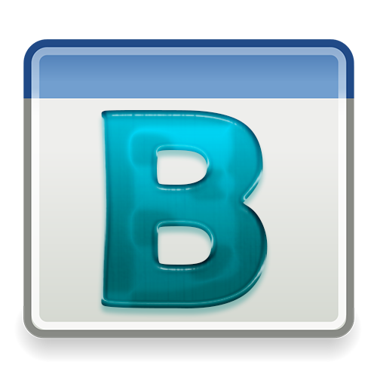




Zero-ish Trust (Defense in Depth)
Access that is:
• Identity driven
Notes:
Identity is stable across boundaries!
Developer velocity. Don’t trade one for the other.
We add some fluffy clouds and extend our network to essentially create a “super network”.
Bridge these networks with other technologies somehow:
VPN overlay
SD WAN
Express routes
VPC peering
…
In the physical world, we were limited to a physical cable. If someone asked you to move a cable to bypass the firewall, and let the public internet access their service, the team would probably hang up on you.
In the cloud world, as long as you have the right permissions, you can do whatever you want. (make this s3 bucket public – amazon says OKAY!)
Perimeters in the cloud are logical, not physical.
What you say is public, is public.
what you say is private, is private.
The cloud can’t distinguish one from the other. There are no topology constraints.
We can debate how risky cloud permissions are based on your IAM controls.
How do we get back to the good old days of the perimeter model? It was NEVER good to begin with. The cloud may be the straw that broke the camel’s back, but we should use this as an opportunity to improve our security posture, instead of moving backwards toward a model that was always broken.
How was is always broken?
The 100% assumption that your perimeter keeps you safe from risk.
Never make a mistake in configuration
Never have unpatched vulnerabilities
Never have zero days against any of the platforms we use.
Insider threats.
It doesn’t matter how big or perfect your wall is, if the threat is on the inside.

Slide 5
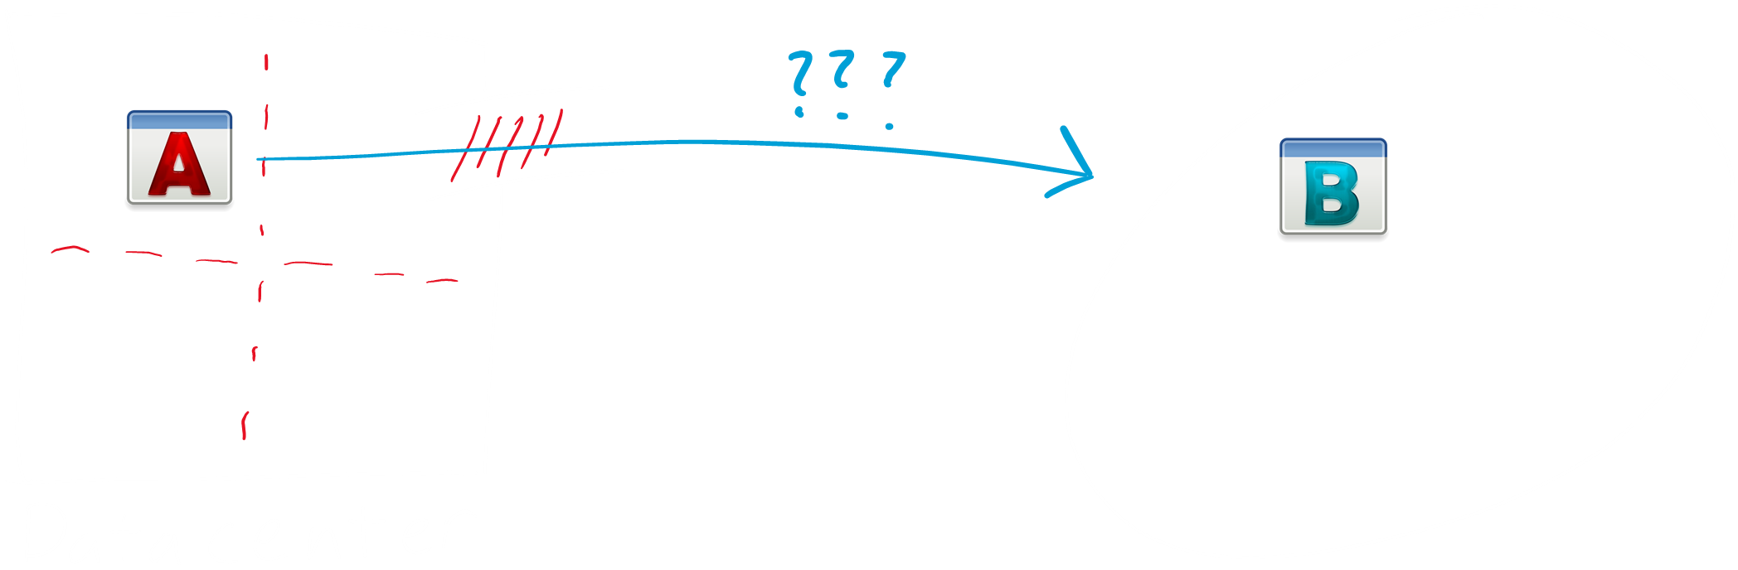



Zero-ish Trust (Defense in Depth)
Access that is:
• Identity driven
• Mutually authenticated
Notes:
Identity is stable across boundaries!
Developer velocity. Don’t trade one for the other.
We add some fluffy clouds and extend our network to essentially create a “super network”.
Bridge these networks with other technologies somehow:
VPN overlay
SD WAN
Express routes
VPC peering
…
In the physical world, we were limited to a physical cable. If someone asked you to move a cable to bypass the firewall, and let the public internet access their service, the team would probably hang up on you.
In the cloud world, as long as you have the right permissions, you can do whatever you want. (make this s3 bucket public – amazon says OKAY!)
Perimeters in the cloud are logical, not physical.
What you say is public, is public.
what you say is private, is private.
The cloud can’t distinguish one from the other. There are no topology constraints.
We can debate how risky cloud permissions are based on your IAM controls.
How do we get back to the good old days of the perimeter model? It was NEVER good to begin with. The cloud may be the straw that broke the camel’s back, but we should use this as an opportunity to improve our security posture, instead of moving backwards toward a model that was always broken.
How was is always broken?
The 100% assumption that your perimeter keeps you safe from risk.
Never make a mistake in configuration
Never have unpatched vulnerabilities
Never have zero days against any of the platforms we use.
Insider threats.
It doesn’t matter how big or perfect your wall is, if the threat is on the inside.

Slide 6

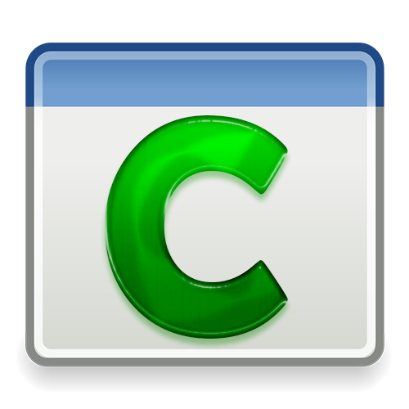


Zero-ish Trust (Defense in Depth)
Access that is:
• Identity driven
• Mutually authenticated
• Authorized
Notes:
Identity is stable across boundaries!
Developer velocity. Don’t trade one for the other.
We add some fluffy clouds and extend our network to essentially create a “super network”.
Bridge these networks with other technologies somehow:
VPN overlay
SD WAN
Express routes
VPC peering
…
In the physical world, we were limited to a physical cable. If someone asked you to move a cable to bypass the firewall, and let the public internet access their service, the team would probably hang up on you.
In the cloud world, as long as you have the right permissions, you can do whatever you want. (make this s3 bucket public – amazon says OKAY!)
Perimeters in the cloud are logical, not physical.
What you say is public, is public.
what you say is private, is private.
The cloud can’t distinguish one from the other. There are no topology constraints.
We can debate how risky cloud permissions are based on your IAM controls.
How do we get back to the good old days of the perimeter model? It was NEVER good to begin with. The cloud may be the straw that broke the camel’s back, but we should use this as an opportunity to improve our security posture, instead of moving backwards toward a model that was always broken.
How was is always broken?
The 100% assumption that your perimeter keeps you safe from risk.
Never make a mistake in configuration
Never have unpatched vulnerabilities
Never have zero days against any of the platforms we use.
Insider threats.
It doesn’t matter how big or perfect your wall is, if the threat is on the inside.

Slide 7



Zero-ish Trust (Defense in Depth)
Access that is:
• Identity driven
• Mutually authenticated
• Authorized
• Time-bound
Notes:
Identity is stable across boundaries!
Developer velocity. Don’t trade one for the other.
We add some fluffy clouds and extend our network to essentially create a “super network”.
Bridge these networks with other technologies somehow:
VPN overlay
SD WAN
Express routes
VPC peering
…
In the physical world, we were limited to a physical cable. If someone asked you to move a cable to bypass the firewall, and let the public internet access their service, the team would probably hang up on you.
In the cloud world, as long as you have the right permissions, you can do whatever you want. (make this s3 bucket public – amazon says OKAY!)
Perimeters in the cloud are logical, not physical.
What you say is public, is public.
what you say is private, is private.
The cloud can’t distinguish one from the other. There are no topology constraints.
We can debate how risky cloud permissions are based on your IAM controls.
How do we get back to the good old days of the perimeter model? It was NEVER good to begin with. The cloud may be the straw that broke the camel’s back, but we should use this as an opportunity to improve our security posture, instead of moving backwards toward a model that was always broken.
How was is always broken?
The 100% assumption that your perimeter keeps you safe from risk.
Never make a mistake in configuration
Never have unpatched vulnerabilities
Never have zero days against any of the platforms we use.
Insider threats.
It doesn’t matter how big or perfect your wall is, if the threat is on the inside.

Slide 8



Zero-ish Trust (Defense in Depth)
Access that is:
• Identity driven
• Mutually authenticated
• Authorized
• Time-bound
• Encrypted Transit
Notes:
Identity is stable across boundaries!
Developer velocity. Don’t trade one for the other.
We add some fluffy clouds and extend our network to essentially create a “super network”.
Bridge these networks with other technologies somehow:
VPN overlay
SD WAN
Express routes
VPC peering
…
In the physical world, we were limited to a physical cable. If someone asked you to move a cable to bypass the firewall, and let the public internet access their service, the team would probably hang up on you.
In the cloud world, as long as you have the right permissions, you can do whatever you want. (make this s3 bucket public – amazon says OKAY!)
Perimeters in the cloud are logical, not physical.
What you say is public, is public.
what you say is private, is private.
The cloud can’t distinguish one from the other. There are no topology constraints.
We can debate how risky cloud permissions are based on your IAM controls.
How do we get back to the good old days of the perimeter model? It was NEVER good to begin with. The cloud may be the straw that broke the camel’s back, but we should use this as an opportunity to improve our security posture, instead of moving backwards toward a model that was always broken.
How was is always broken?
The 100% assumption that your perimeter keeps you safe from risk.
Never make a mistake in configuration
Never have unpatched vulnerabilities
Never have zero days against any of the platforms we use.
Insider threats.
It doesn’t matter how big or perfect your wall is, if the threat is on the inside.

Slide 9



Zero-ish Trust (Defense in Depth)
Access that is:
• Identity driven
• Mutually authenticated
• Authorized
• Time-bound
• Encrypted Transit
• Audited & logged
Notes:
Identity is stable across boundaries!
Developer velocity. Don’t trade one for the other.
We add some fluffy clouds and extend our network to essentially create a “super network”.
Bridge these networks with other technologies somehow:
VPN overlay
SD WAN
Express routes
VPC peering
…
In the physical world, we were limited to a physical cable. If someone asked you to move a cable to bypass the firewall, and let the public internet access their service, the team would probably hang up on you.
In the cloud world, as long as you have the right permissions, you can do whatever you want. (make this s3 bucket public – amazon says OKAY!)
Perimeters in the cloud are logical, not physical.
What you say is public, is public.
what you say is private, is private.
The cloud can’t distinguish one from the other. There are no topology constraints.
We can debate how risky cloud permissions are based on your IAM controls.
How do we get back to the good old days of the perimeter model? It was NEVER good to begin with. The cloud may be the straw that broke the camel’s back, but we should use this as an opportunity to improve our security posture, instead of moving backwards toward a model that was always broken.
How was is always broken?
The 100% assumption that your perimeter keeps you safe from risk.
Never make a mistake in configuration
Never have unpatched vulnerabilities
Never have zero days against any of the platforms we use.
Insider threats.
It doesn’t matter how big or perfect your wall is, if the threat is on the inside.

Slide 10



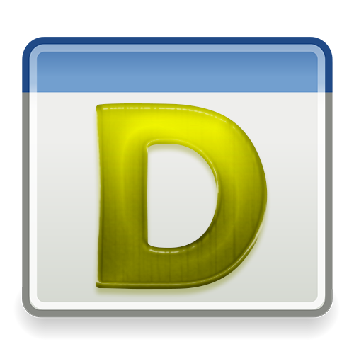
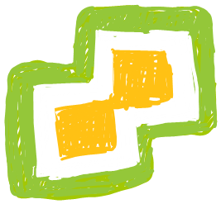

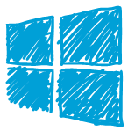
Removing the IP dependency for security
Partners
External Customers
Remote Users
Notes:
Identity is stable across boundaries!
Developer velocity. Don’t trade one for the other.
We add some fluffy clouds and extend our network to essentially create a “super network”.
Bridge these networks with other technologies somehow:
VPN overlay
SD WAN
Express routes
VPC peering
…
In the physical world, we were limited to a physical cable. If someone asked you to move a cable to bypass the firewall, and let the public internet access their service, the team would probably hang up on you.
In the cloud world, as long as you have the right permissions, you can do whatever you want. (make this s3 bucket public – amazon says OKAY!)
Perimeters in the cloud are logical, not physical.
What you say is public, is public.
what you say is private, is private.
The cloud can’t distinguish one from the other. There are no topology constraints.
We can debate how risky cloud permissions are based on your IAM controls.
How do we get back to the good old days of the perimeter model? It was NEVER good to begin with. The cloud may be the straw that broke the camel’s back, but we should use this as an opportunity to improve our security posture, instead of moving backwards toward a model that was always broken.
How was is always broken?
The 100% assumption that your perimeter keeps you safe from risk.
Never make a mistake in configuration
Never have unpatched vulnerabilities
Never have zero days against any of the platforms we use.
Insider threats.
It doesn’t matter how big or perfect your wall is, if the threat is on the inside.

Slide 11
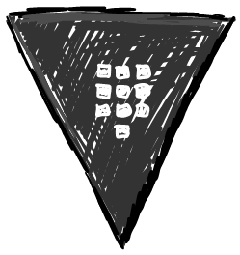
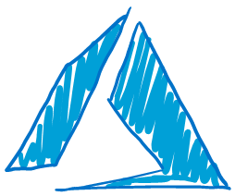
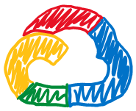
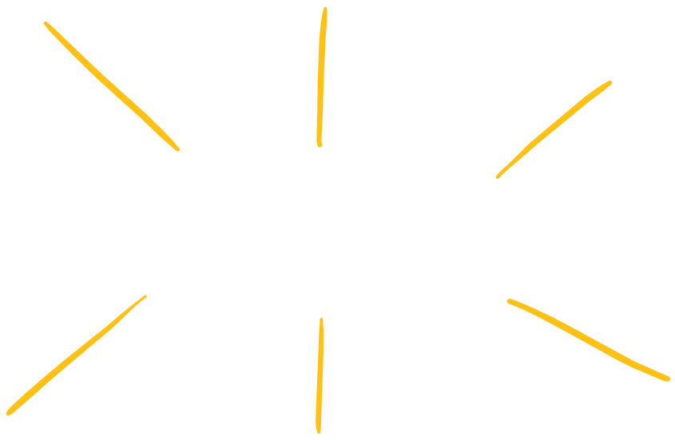
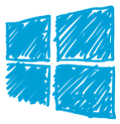



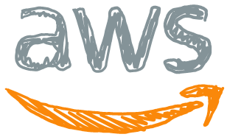
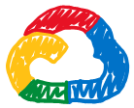
















HashiCorp Vault
Partners
Customers
Remote users
Notes:
Identity is stable across boundaries!
Developer velocity. Don’t trade one for the other.
We add some fluffy clouds and extend our network to essentially create a “super network”.
Bridge these networks with other technologies somehow:
VPN overlay
SD WAN
Express routes
VPC peering
…
In the physical world, we were limited to a physical cable. If someone asked you to move a cable to bypass the firewall, and let the public internet access their service, the team would probably hang up on you.
In the cloud world, as long as you have the right permissions, you can do whatever you want. (make this s3 bucket public – amazon says OKAY!)
Perimeters in the cloud are logical, not physical.
What you say is public, is public.
what you say is private, is private.
The cloud can’t distinguish one from the other. There are no topology constraints.
We can debate how risky cloud permissions are based on your IAM controls.
How do we get back to the good old days of the perimeter model? It was NEVER good to begin with. The cloud may be the straw that broke the camel’s back, but we should use this as an opportunity to improve our security posture, instead of moving backwards toward a model that was always broken.
How was is always broken?
The 100% assumption that your perimeter keeps you safe from risk.
Never make a mistake in configuration
Never have unpatched vulnerabilities
Never have zero days against any of the platforms we use.
Insider threats.
It doesn’t matter how big or perfect your wall is, if the threat is on the inside.

Slide 12
Zero-trust Identity driven controls
Vault
Global Identity Broker
Maps any identity platform to a Vault identity
Platform / runtime agnostic
Consul
Machine-to-Machine Identity
Service-to-service communications
Platform / runtime agnostic
Boundary
Human-to-machine Identity
Human to machine communications
Platform / runtime agnostic
Notes:
Great! Customer agrees with us! They care about zero-trust across these vectors.
What are the controls that we can use to achieve these goals.
The customer cares about the whole puzzle, not just the individual pieces!
Yet we keep focusing on the pieces.
in order to embrace these zero trust principles, you must be platform agnostic. You must scale across your entire enterprise.
how can you look at a point solution like Istio, when you have these goals.
If they’re not talking to you to solve this problem? Who are they talking to?

Slide 13
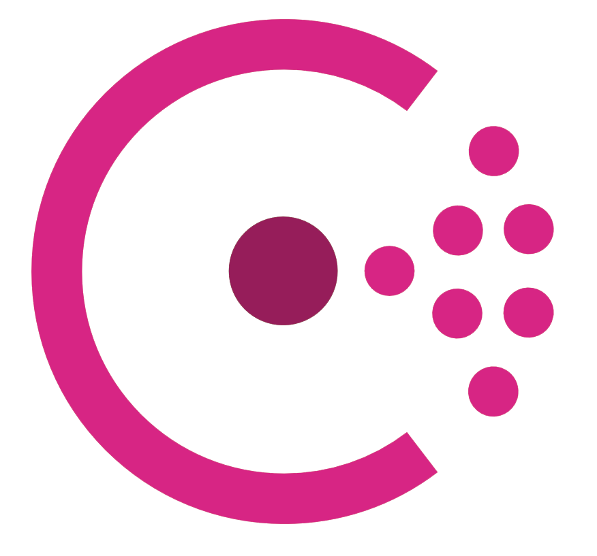
What is Consul Enterprise?
HashiCorp Consul Enterprise is an API-driven secure service networking solution. It provides the underlying platform to discover services, automate network configurations, and enable zero-trust connectivity across any cloud or runtime.
For additional descriptions or instructions that expand on this workshop, please see the docs, API guide, and learning site:
https://www.consul.io/docs/
https://www.consul.io/api/
https://learn.hashicorp.com/consul/

Slide 14


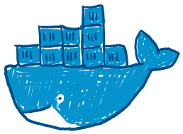
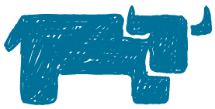
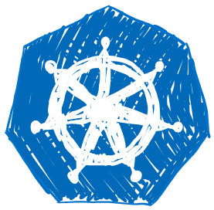
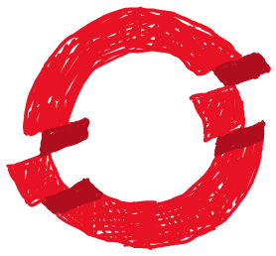
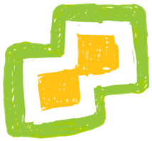

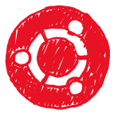


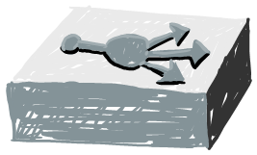
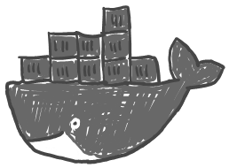
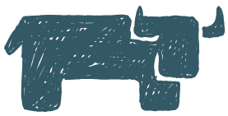
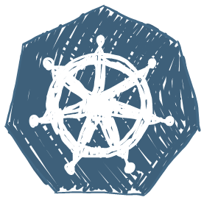
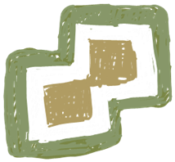


Platform Fragmentation
Dev Pet Project
Shadow IT
Remote Users
& Developers
Partners
Customers
Notes:
Identity is stable across boundaries!
Developer velocity. Don’t trade one for the other.
We add some fluffy clouds and extend our network to essentially create a “super network”.
Bridge these networks with other technologies somehow:
VPN overlay
SD WAN
Express routes
VPC peering
…
In the physical world, we were limited to a physical cable. If someone asked you to move a cable to bypass the firewall, and let the public internet access their service, the team would probably hang up on you.
In the cloud world, as long as you have the right permissions, you can do whatever you want. (make this s3 bucket public – amazon says OKAY!)
Perimeters in the cloud are logical, not physical.
What you say is public, is public.
what you say is private, is private.
The cloud can’t distinguish one from the other. There are no topology constraints.
We can debate how risky cloud permissions are based on your IAM controls.
How do we get back to the good old days of the perimeter model? It was NEVER good to begin with. The cloud may be the straw that broke the camel’s back, but we should use this as an opportunity to improve our security posture, instead of moving backwards toward a model that was always broken.
How was is always broken?
The 100% assumption that your perimeter keeps you safe from risk.
Never make a mistake in configuration
Never have unpatched vulnerabilities
Never have zero days against any of the platforms we use.
Insider threats.
It doesn’t matter how big or perfect your wall is, if the threat is on the inside.

Slide 15
Goals & Challenges
What do we really want?
• Stability and consistency without sacrificing productivity.
• Implement zero-trust across all communications and access.
• While reducing the burden on security and network teams.
• While accelerating velocity for Developers and removing technical debt.
Challenges
• Manual & complex processes in application delivery
• Managing risk whenever changes are made
• Discovering and tracking services and service health at a GLOBAL level
• Lack of a controlled perimeter
• Diverse multi-everything:
• Clouds, Regions / AZs, runtime platforms (BM, VMs, Containers)
• Managing / brokering disparate Identities
• Cloud native vs JWT vs “…”
• Secure networking is hard

Slide 16


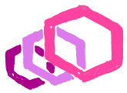

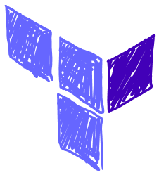

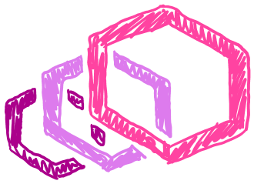
Consul as the single point of truth for services
Consul Service Registry
Consul Terraform Sync
Envoy Data Plane
Notes:
Identity is stable across boundaries!
Developer velocity. Don’t trade one for the other.
We add some fluffy clouds and extend our network to essentially create a “super network”.
Bridge these networks with other technologies somehow:
VPN overlay
SD WAN
Express routes
VPC peering
…
In the physical world, we were limited to a physical cable. If someone asked you to move a cable to bypass the firewall, and let the public internet access their service, the team would probably hang up on you.
In the cloud world, as long as you have the right permissions, you can do whatever you want. (make this s3 bucket public – amazon says OKAY!)
Perimeters in the cloud are logical, not physical.
What you say is public, is public.
what you say is private, is private.
The cloud can’t distinguish one from the other. There are no topology constraints.
We can debate how risky cloud permissions are based on your IAM controls.
How do we get back to the good old days of the perimeter model? It was NEVER good to begin with. The cloud may be the straw that broke the camel’s back, but we should use this as an opportunity to improve our security posture, instead of moving backwards toward a model that was always broken.
How was is always broken?
The 100% assumption that your perimeter keeps you safe from risk.
Never make a mistake in configuration
Never have unpatched vulnerabilities
Never have zero days against any of the platforms we use.
Insider threats.
It doesn’t matter how big or perfect your wall is, if the threat is on the inside.

Slide 17
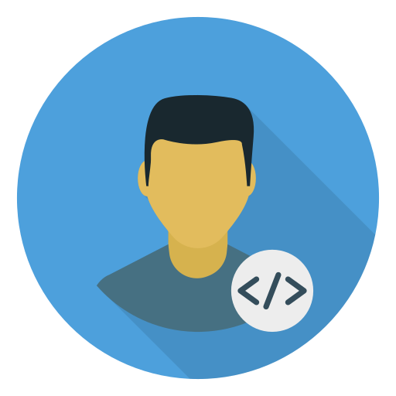


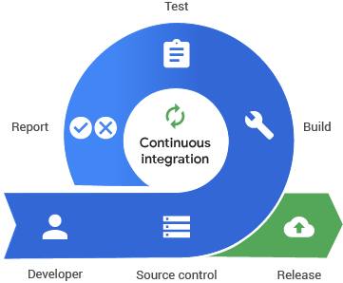
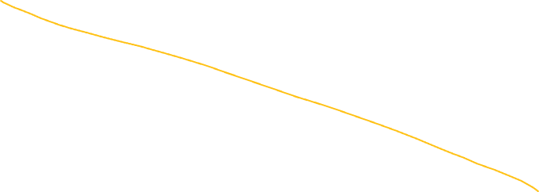

DevOps CI/CD Objectives and Disillusionments
Consul Terraform Sync
Continuous Delivery
Continuous
Disappointment
Automated
Deployment
Manual
Handoff
Manual Deployment
Service
Creation
Service
Consumption
Network & Security Automation
ITIL
CLI / GUI
Continuous Disappointment

Slide 18
What does HashiCorp Consul provide?
Establishes a single control point for all infrastructure
Reduces complexity from fragmentation
Removes development technical debt
(encryption, deployment logic, authentication, authorization)
Enables end-to-end automation of network infrastructure
Agnostically Provides Service-Service communication that is:
Identity driven
Mutually authenticated
Authorized
Time-bound
Transit Encrypted
Audited & logged
Notes:
We already do these principles for Vault. Now we’re going to apply them to Consul.
How do you repeatedly frame the problem statement with your customers.
Who gives these services their identity? Where does consul get the services’ identity from? Vault.
If you ingrain these principles and goals into your mind: you will stumble upon Consul opportunities.
You need to apply these principles to both!
Access
Communication
Your customers are actively solving this challenges, with or without you.

Slide 19
3 Core Consul Use Cases
Global Service Registry & Discovery
Network Infrastructure Automation
Service Communications (Mesh)

Slide 20
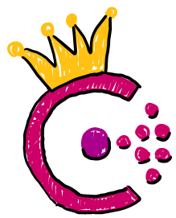







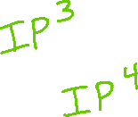






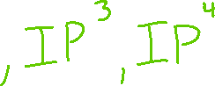

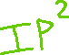

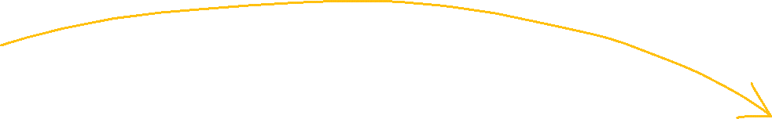
Consul - Service Discovery
Notes:
The first stage, is to have Service Discovery.
------------------------------------------
At the most basic level, we have two applications that need to talk to each other, Application A and Application B.
------------------------------------------
And today, we constrain them to flow through a firewall that will provide authorization.
------------------------------------------
And a loadbalancer that provides Naming.
------------------------------------------
And the application is going to transit something like this.
------------------------------------------
Application A knows where App B lives , because it has the IP address of App B or the loadbalancer, hard-coded in it.
------------------------------------------
The first level challenge in this journey is : “How do we stand up Consul to act as a central Registry?”
As these services get deployed, they get registered.
It might be that A is running on a physical machine and B is running in a container on Kubernetes in the cloud.
It doesn’t really matter. Consul has a birds eye view of all the applications in our infrastructure and where they’re running.
And this registry can be queried via:
------------------------------------------
DNS
Or RestAPI
So instead of the Application A hard coding IP2
------------------------------------------
It can hard code a name:
------------------------------------------
svcB.service.consul
This will be resolved via DNS to the IP.
------------------------------------------
And now we no longer need to use a loadbalancer as a naming construct.
------------------------------------------
When B scales Up or Down, Consul maintains an up-to-date registry
------------------------------------------
And if an instance fails:
------------------------------------------
Consul is able to dynamically mask all of this.
…
So we start to move away from using a loadbalancer as a fixed naming device, and really only use it in the case where we have tons of requests a second and we need to have loadbalancing capability.

Slide 21





Consul - Network Infrastructure Automation

Slide 22




















Consul – Service Mesh
Notes:
The way this works
------------------------------------------
Is that alongside our applications, we deploy a side-car proxy
------------------------------------------
So when A wants to talk to B, it actually talks outward through this proxy.
------------------------------------------
The outbound proxy is responsible for the Service Discovery, as well as the LoadBalancing.
The proxy will do the work to discover which instance of Service B we should actually send traffic to.
------------------------------------------
And then it initiates the connection.
The receiving end is going to upgrade this connection to Mutual TLS.
------------------------------------------
Both sides have to present a certificate to identify themselves.
This enables us to do Authorization, so A knows for certain it’s talking to B, and vice versa.
------------------------------------------
Another benefit mutual TLS gives us is that we are now employing a zero trust network model. We can assume the network is hostile, and as such all of the data is being end-to-end encrypted.
You may recall a few years back, that one of Google’s data centers was effectively compromised and snooped on via a government agency and as a result, they started forcing encrypting on their applications internally.
This Consul architecture would have prevented this type of attack.
------------------------------------------
And we can tie this authorization back to rules in the Consul registry, via our Service Access Graph, that we call “intentions”.
We can say: App A can talk to B, but B cannot talk to D, and so forth.
------------------------------------------
This removes the requirement of having firewalls between all of our applications.
And it’s key to understand that unlike a firewall rule, Consul rules pertain to logical names, not IPs.
If you had 50 Web servers and 5 Databases, this single intention rule in Consul, could turn into 250 allow rules in a firewall.
This results in a massively lower firewall complexity at scale.
…
To recap:
The crawl phase is about making the service registry process more dynamic, so we don’t have to hardcode IPs as we scale a bunch of services. We don’t want to have to worry about static things breaking as we’re moving quickly.
The walk phase is about automating changes to our networking components, using the Consul registry.
The Run phase is about simplifying and removing network middleware from the east/west network path.
However, there is still a need for firewalls and loadbalancers in the North / South path.

Slide 23




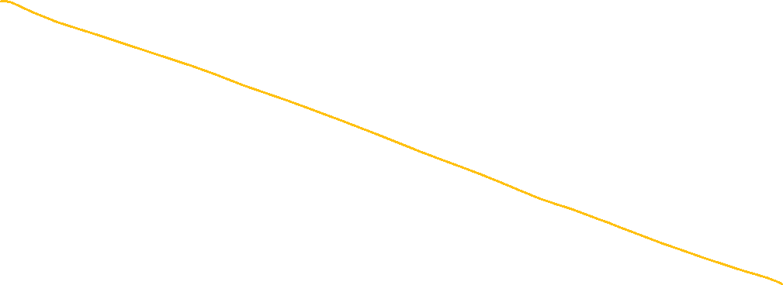











Consul Mesh Gateways

Slide 24
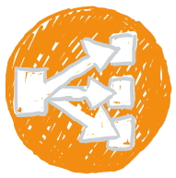














Consul Mesh Gateways

Slide 25











Consul Mesh Gateways

Slide 26



Consul Terminating Gateways

Slide 27















Consul Ingress Gateways

Slide 28
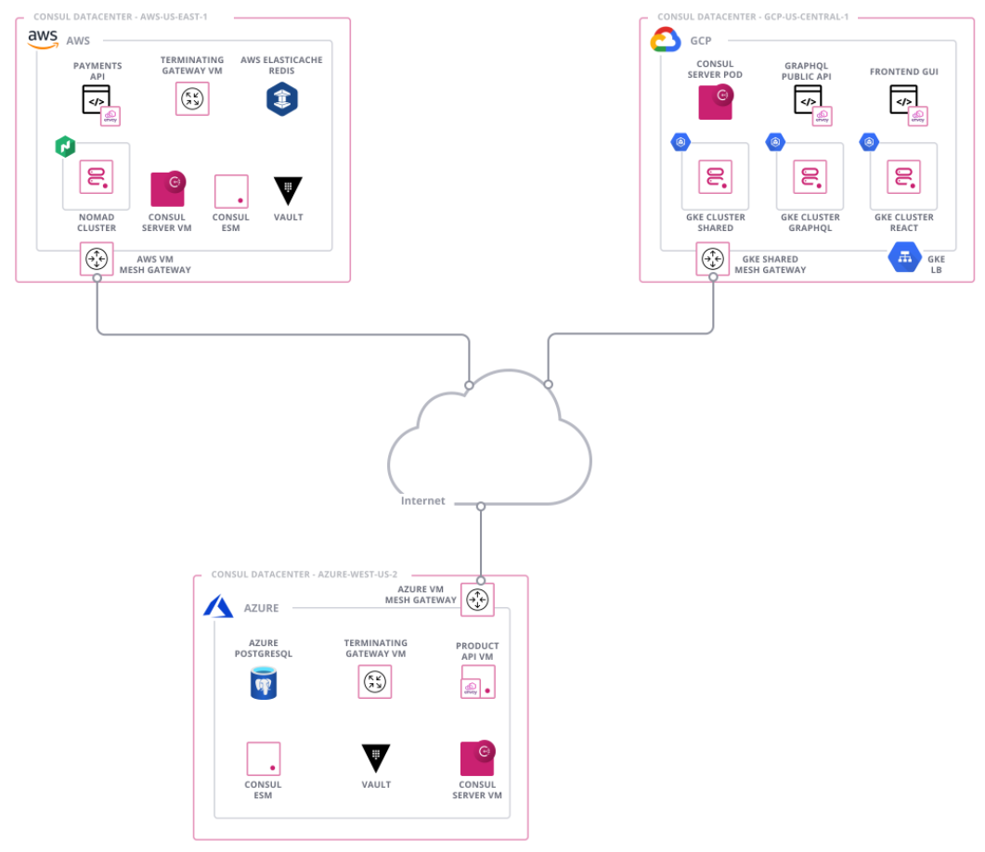
Consul Enterprise: Art of the Possible

Slide 29
Thank you!
Notes:
Identity is stable across boundaries!
Developer velocity. Don’t trade one for the other.
We add some fluffy clouds and extend our network to essentially create a “super network”.
Bridge these networks with other technologies somehow:
VPN overlay
SD WAN
Express routes
VPC peering
…
In the physical world, we were limited to a physical cable. If someone asked you to move a cable to bypass the firewall, and let the public internet access their service, the team would probably hang up on you.
In the cloud world, as long as you have the right permissions, you can do whatever you want. (make this s3 bucket public – amazon says OKAY!)
Perimeters in the cloud are logical, not physical.
What you say is public, is public.
what you say is private, is private.
The cloud can’t distinguish one from the other. There are no topology constraints.
We can debate how risky cloud permissions are based on your IAM controls.
How do we get back to the good old days of the perimeter model? It was NEVER good to begin with. The cloud may be the straw that broke the camel’s back, but we should use this as an opportunity to improve our security posture, instead of moving backwards toward a model that was always broken.
How was is always broken?
The 100% assumption that your perimeter keeps you safe from risk.
Never make a mistake in configuration
Never have unpatched vulnerabilities
Never have zero days against any of the platforms we use.
Insider threats.
It doesn’t matter how big or perfect your wall is, if the threat is on the inside.

